Slide 1
Detail ProJet Report (DPR)
Global Energy Trade Analysis (1990-2014)
Author: Dibyendu Biswas
Version: 1.0

Slide 2
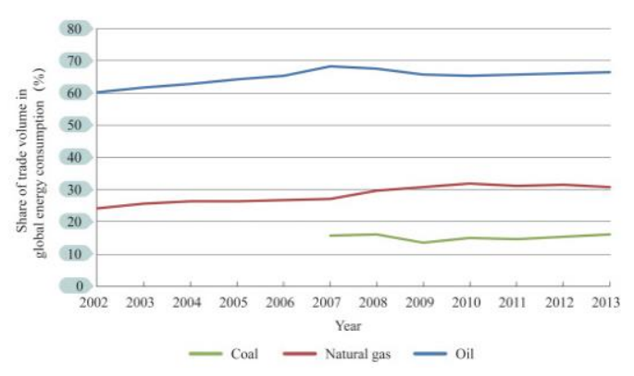
INTRODUCTION
Taking place primarily in the fossil fuels sector, global energy trading is rising steadily on a total volume basis. The distribution of fossil energy production and consumption is highly imbalanced, requiring the capability to optimize allocations of energy resources across the world. Transnational and intercontinental energy trade flows have been expanding increasingly along with the development and improvement of energy transport networks, including ocean transport, railway, and oil/gas transmission networks. In 2013, transcontinental fossil energy trade flows globally amounted to 6.3 billion tons of standard coal, with oil, gas, and coal accounting for 63, 22, and 15%, respectively. Fig. 1.1 shows the change in the trade volume of different fossil energies as a percentage of global consumption between 2002 and 2013.

Slide 3
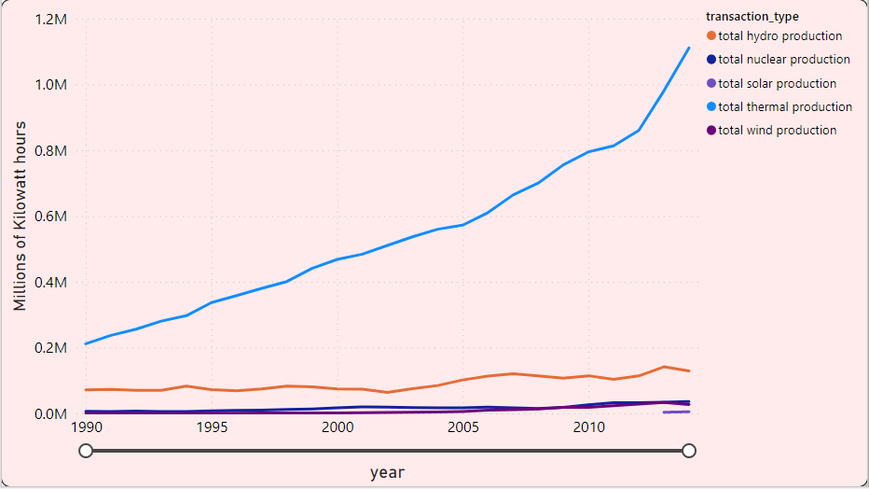
Energy Production in India
Total Thermal Electricity Production is approx. 13621.99k millions of kilowatt-hours.
Total Hydro Electricity Production is approx. 2280.02k millions of kilowatt-hours.
Total Nuclear Electricity Production is approx. 420.50k million of kilowatt hours.
Total Wind Electricity Production is approx. 208.90k million of kilowatt-hours.
Total Solar Electricity Production is approx. 8.45k million of kilowatt-hours.
From year 1990 to 2010, the production of electricity is increase rapidly that show in Fig. 1.2.

Slide 4
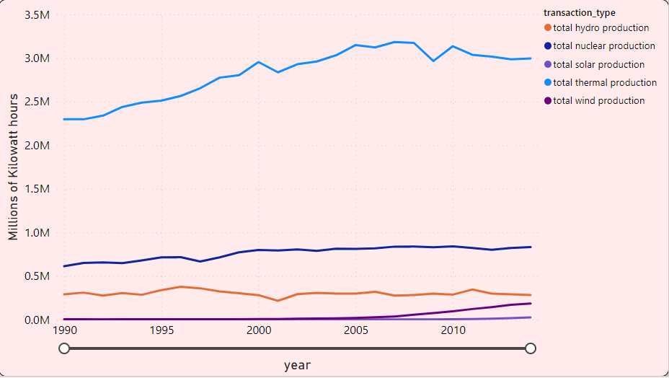
Energy Production in United States
Total Thermal Electricity Production is approx. 70645.01k millions of kilowatt-hours.
Total Hydro Electricity Production is approx. 7520.14k millions of kilowatt-hours.
Total Nuclear Electricity Production is approx. 19065.80k million of kilowatt hours.
Total Wind Electricity Production is approx. 1002.37k million of kilowatt-hours.
Total Solar Electricity Production is approx. 81.67k million of kilowatt-hours.
Total Geothermal Electricity Production is approx. 410.36k million of kilowatt-hours.
From year 1990 to 2010, the production of electricity is increase rapidly that show in Fig. 1.3.

Slide 5
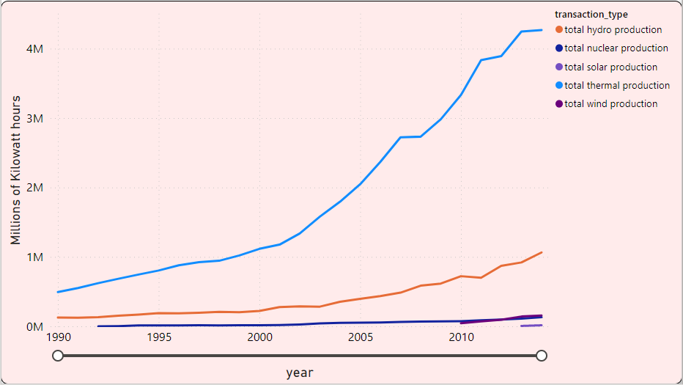
Energy Production in China
Total Thermal Electricity Production is approx. 47107.55k millions of kilowatt-hours.
Total Hydro Electricity Production is approx. 9912.32k millions of kilowatt-hours.
Total Nuclear Electricity Production is approx. 1051.16k million of kilowatt hours.
Total Wind Electricity Production is approx. 508.21k million of kilowatt-hours.
Total Solar Electricity Production is approx. 20.75k million of kilowatt-hours.
From year 1990 to 2010, the production of electricity is increase rapidly that show in Fig. 1.3.

Slide 6
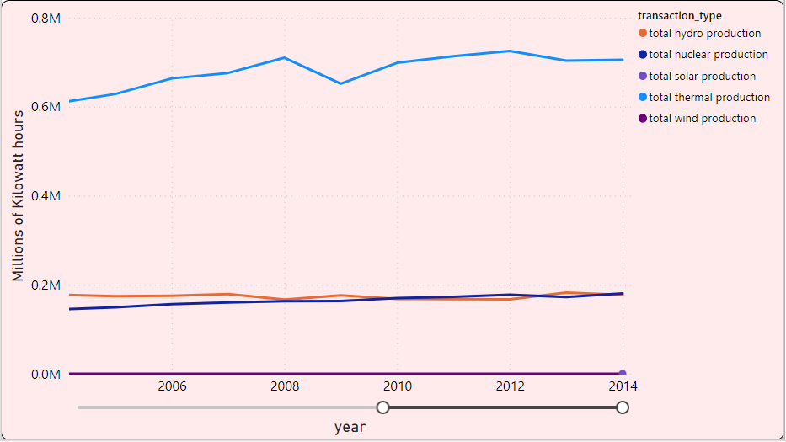
Energy Production in Russian Federation
Total Thermal Electricity Production is approx. 14682.31k millions of kilowatt-hours.
Total Hydro Electricity Production is approx. 3907.01k millions of kilowatt-hours.
Total Nuclear Electricity Production is approx. 3251.96k million of kilowatt hours.
Total Wind Electricity Production is approx. 0.17k million of kilowatt-hours.
Total Solar Electricity Production is approx. 0.16k million of kilowatt-hours.
Total Geothermal Electricity Production is approx. 5.96k million of kilowatt-hours.
From year 1990 to 2010, the production of electricity is increase rapidly that show in Fig. 1.3.

Slide 7
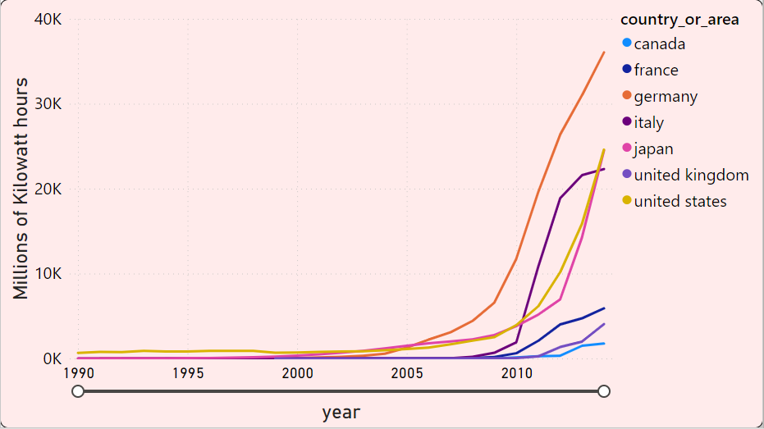
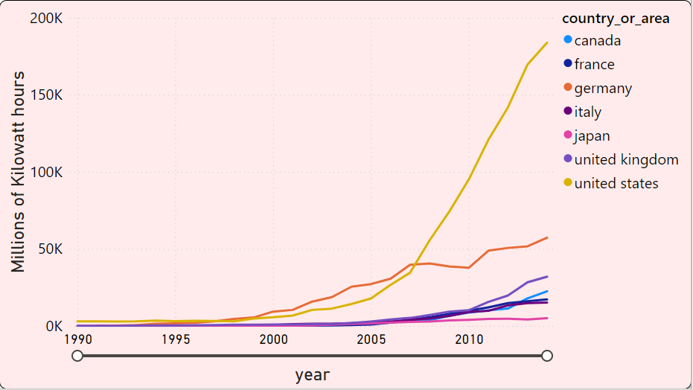
Energy Production in G7 Countries
Total Solar Electricity Production is approx. 400.91k million of kilowatt-hours.
Total Wind Electricity Production is approx. 1983.62k million of kilowatt-hours.

Slide 8
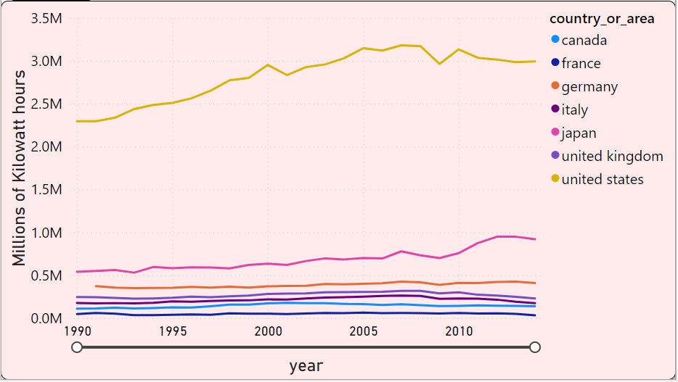
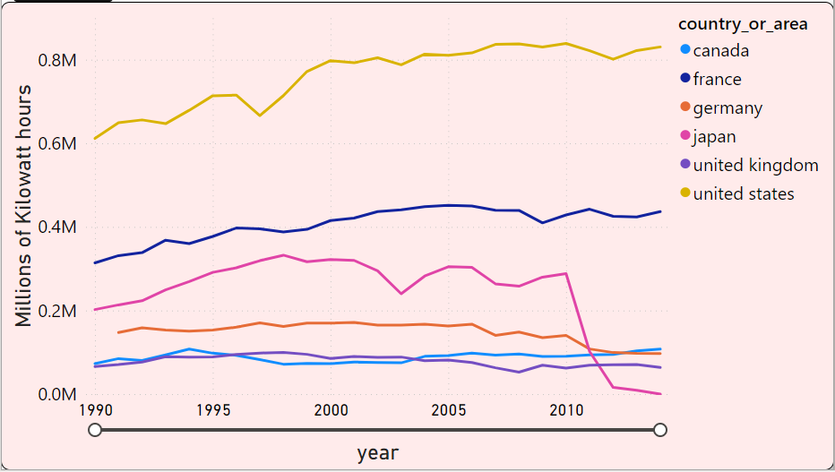
Energy Production in G7 Countries
Total Thermal Electricity Production is approx. 114178.64 million of kilowatt-hours.
Total Nuclear Electricity Production is approx. 42987. million of kilowatt-hours.

Slide 9
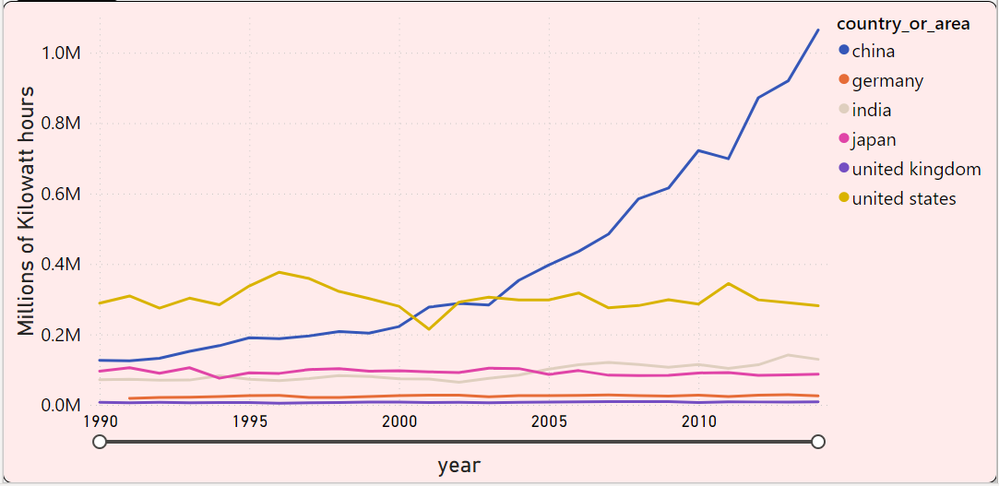
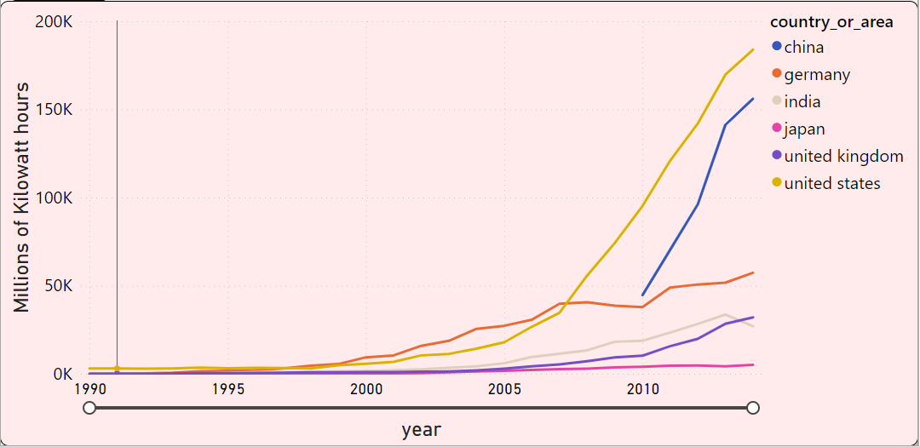
Renewable Energy Production In Top 6 Countries According To GDP
Hydro Electricity Production: 22809.67k millions of kilowatt-hours.
Wind Electricity Production: 2426.15k millions of kilowatt-hours

Slide 10
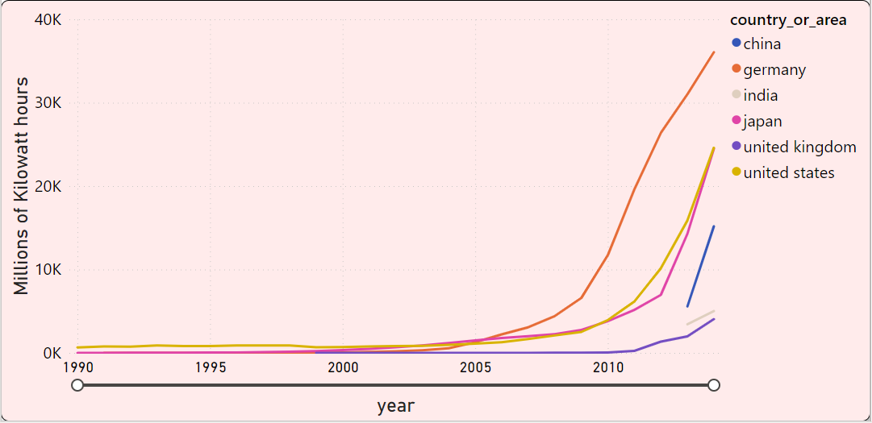
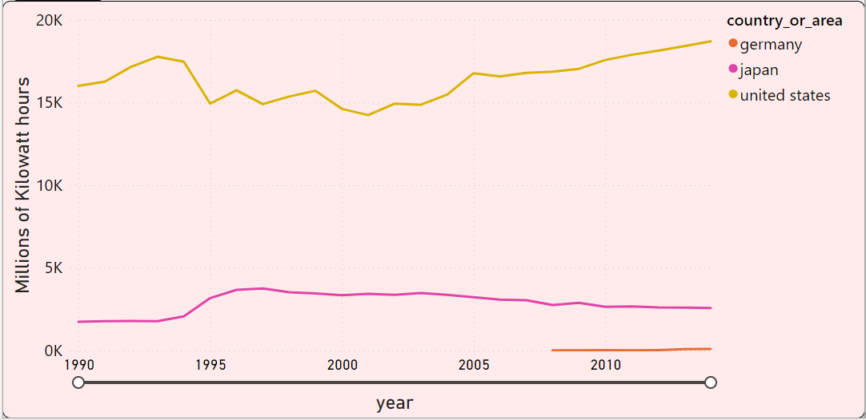
Renewable Energy Production In Top 6 Countries According To GDP
Solar Electricity Production: 331.58k million of kilowatt-hours
Geothermal Electricity Production: 482.47k million of kilowatt-hours.

Slide 11
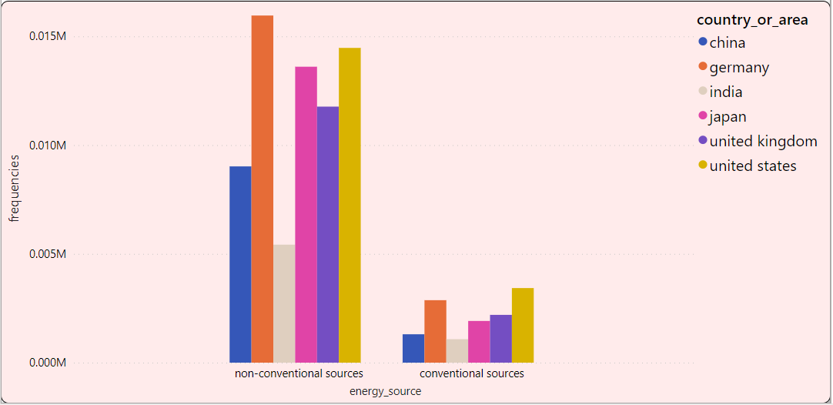
Consumption of Conventional & Non-Conventional Energy in India, United States, Japan, Germany, China, United Kingdom

Slide 12
Conclusions
United States produce more electricity using coal,
United States produce more nuclear electricity than others countries,
United States produce more carbon than others countries,
India was started to produce the electricity using renewable sources,
Germany produce more solar electricity than others G7 countries,
United States produce more electricity than others G7 countries,
India & China import more coal products than others countries,
Russian Federation is export more coal & petroleum than others countries,

Slide 13
------------------------ Thank You ----------------------

